Slide 1

Annual Report 2018/2019
Delana Lawson
4/10/2019

Slide 2
Highlights OF 2018/19
We heard from over 2500 people in different ways
Access to GP Appointments, Mental Health Action Group, Safe Guarding Adults, SRFT Test for Change, Health Access & Homelessness
We had 21 Volunteers involved in all our projects
145 access our signposting and information service
We visited 26 services and marketed ourselves at 15 community events
Through various projects above we’ve made recommendations with 52 improvements being made.

Slide 3
Challenges
Profile and Visibility with limited resources
Developments at a Greater Manchester Level increased complexity of health & Care system
Diversity of volunteers and maintaining involvement across different projects
Static Company membership numbers

Slide 4
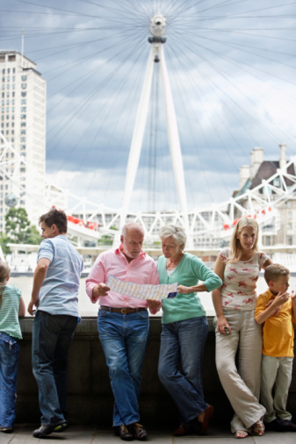
The Future
Good Governance
More Volunteers
Develop membership package and HWS Network
‘Least Heard’
HWS Profile and Reach
Social Value

